Slide 1
Trick Words
Mrs. LaStella’s First Graders
By PresenterMedia.com

Slide 2
the

Slide 3
a

Slide 4
and

Slide 5
is
his

Slide 6
of

Slide 7
as
has

Slide 8
to
into

Slide 9
we
he
she
be
me

Slide 10
for
or

Slide 11
you
your

Slide 12
I

Slide 13
they

Slide 14
was

Slide 15
one

Slide 16
said

Slide 17
from

Slide 18
have

Slide 19
do

Slide 20
does

Slide 21
were

Slide 22
are

Slide 23
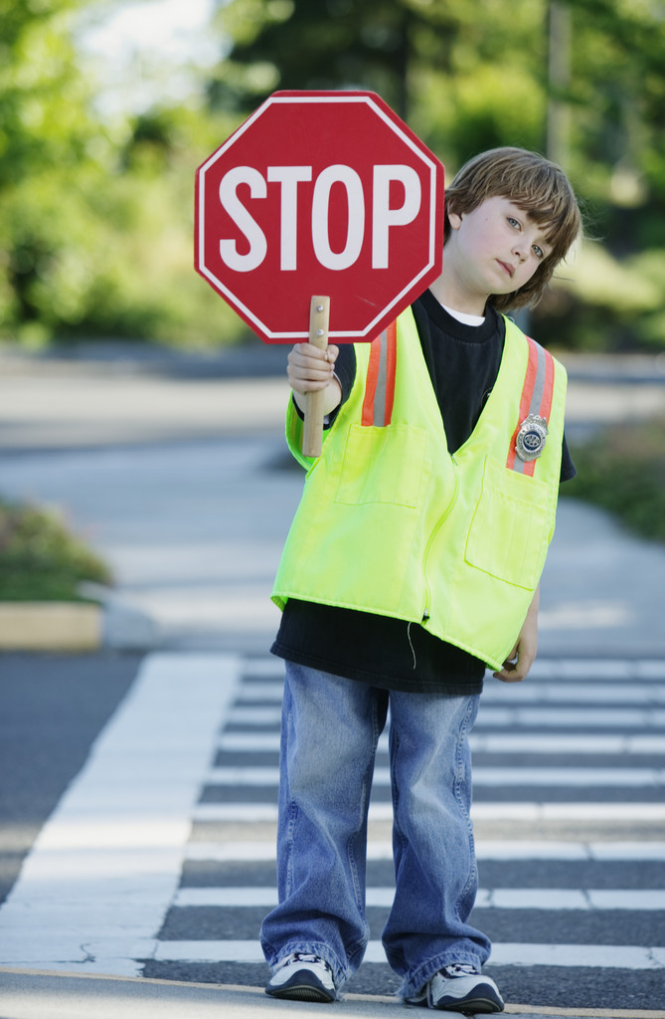

Slide 24
who

Slide 25
what

Slide 26
when

Slide 27
where

Slide 28
there

Slide 29
here

Slide 30
why

Slide 31
by

Slide 32
my

Slide 33
try

Slide 34
put

Slide 35
two

Slide 36
too

Slide 37
very

Slide 38
also

Slide 39
some

Slide 40
come

Slide 41
would

Slide 42
could

Slide 43
should

Slide 44
her

Slide 45
over

Slide 46
over

Slide 47
number

Slide 48
say

Slide 49
says

Slide 50
see

Slide 51
between

Slide 52
each

Slide 53
any

Slide 54
many

Slide 55
how

Slide 56
now

Slide 57
down

Slide 58
out

Slide 59
about

Slide 60
our

Slide 61
friend

Slide 62
other

Slide 63
another

Slide 64
nothing

Slide 65
people

Slide 66
month

Slide 67
little

Slide 68
been

Slide 69
own

Slide 70
want

Slide 71
Mr.

Slide 72
Mrs.

Slide 73
work

Slide 74
word

Slide 75
write

Slide 76
being

Slide 77
their

Slide 78
first

Slide 79
look

Slide 80
good

Slide 81
new

Slide 82
water

Slide 83
called

Slide 84
day

Slide 85
may

Slide 86
way

